Slide 2
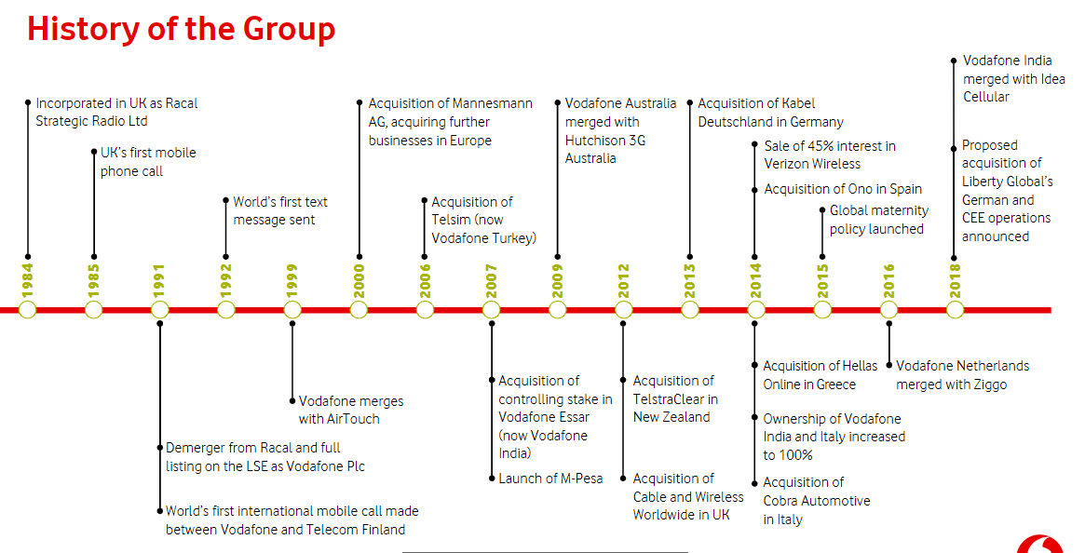

Slide 3
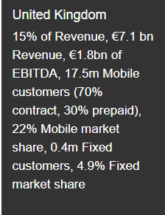
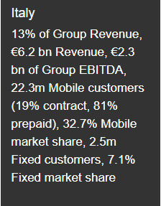
Some of the countries in which we operate (2018)
Source: https://www.vodafone.com/content/index/investors/about_us.html

Slide 4
11% of total revenues

Slide 6
KEY FINANCIALS

Slide 7
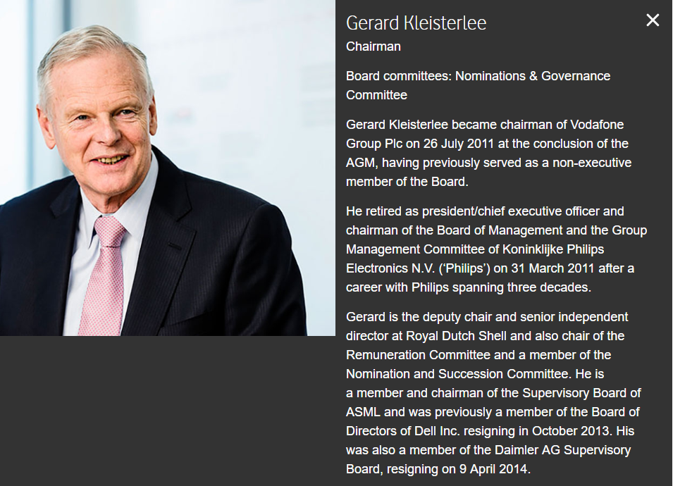
Key people

Slide 8
Key people

Slide 9
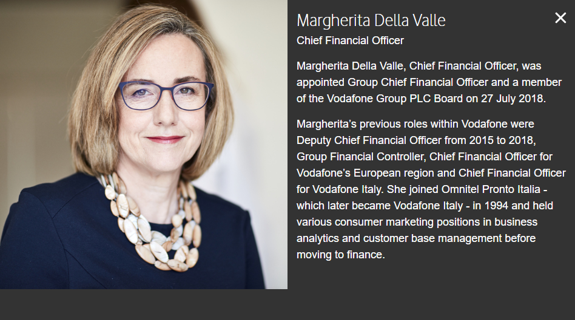
Key people

